Slide 1
Complexity, P, and NP Lecture 6
John P. Baugh, Ph.D. University of Michigan - Dearborn

Slide 2
Introduction
We will now take a look at different ways to categorize problems
We assume problems can be encoded into languages too, so clearly, they can then be fed into a Turing Machine
We’ll discuss reduction of problems, decision problems (again!) and the hierarchy of complexity classes
We’ll discuss the perplexing multi-million dollar question, “Is P = NP?”

Slide 3
Lecture 6 Contents
Introduction
Reducibility
Decision problems
The classes P and NP
NP-completeness and polynomial time reducibility

Slide 4
Reducibility and Decision Problems
“A computer once beat me at chess, but it was no match for me at kickboxing.” – Emo Philips

Slide 5
Complexity Class Orders
Mathematicians have attempted to answer questions about levels of difficulty by making a hierarchy of problems called complexity classes
The following orders will be important to our discussion later of complexity classes P and NP
We discuss specific complexity class orders when we discuss Big-O notation (asymptotic classes), with classes such as:
O(1) Constant
O(log n) Logarithmic
O(n) Linear
O(n log n) Linear-logarithmic
O(n²) Quadratic
O(n³) Cubic
O(2^{n}) Exponential

Slide 6
Reducibility
The definition may seem counter-intuitive at first, but will hopefully make sense later
If a problem A can be solved using an algorithm that solves problem B, we say that A can be reduced to B
Contrary to what you might be thinking, we are saying that this implies B is at least as hard as A
Or, B is at least as complex as A

Slide 7
Reduction Example
Largest vs Sorting
The problem LARGEST means we want to find the largest integer in a list of integers
The problem SORTING means we want to sort the integers in descending order
We can say that LARGEST reduces to SORTING
In other words, SORTING is at least as hard as LARGEST
Practically speaking, we could
Sort the list in descending order (SORTING)
Grab the value at the front (LARGEST)
We’ve essentially used SORTING to solve LARGEST (A reduces to B, LARGEST reduces to SORTING)
Don’t think of reduction as saying that first problem is hard – it is in fact EASIER

Slide 8
Decision Problems
Once again, we are reminded of our friend the decision problem
A decision problem is a problem for which the solution produces a “yes” or “no” answer
We use decision problems in many analyses because they are some of the simpler problems
Language recognition problems are all decision problems

Slide 9
The Classes P and NP
Life is like math… if it goes too easy, something is wrong - Demotivational Poster

Slide 10
Tractability
A problem is considered tractable if it can be solved for large input in O(n^{α}) where α is a constant
A problem is considered intractable if it is not tractable
See previous definition

Slide 11
The class P
P is a class (classification) of problems (that is, a set of problems), typically viewed as decision problems, where there is an algorithm that can solve the problem in p(n) worst case time
p as a function indicates polynomality
In other words, any problem that can be solved in polynomial time is a member of the class P
Specific to decision problems, we say if a problem can be decided in polynomial time, it is in class P

Slide 12
Examples of problems in P
Some examples of the problems that are in P (solvable in polynomial time) are
Sorting a list of numbers
Searching a list of numbers
Finding a shortest path in a graph
Performing matrix multiplication
So, intractable problems are those whose growth rate are so large, it is impractical to solve them for large instances of input
These are the problems that cannot be solved in polynomial time

Slide 13
Examples of intractable problems
Generating the power set of a set S
The power set is the set of all subsets
Finding a Hamiltonian cycle (or path) in a graph
Visiting every node in the graph only once
Factoring integers
Decomposing a composite (non-prime) integer into the product of smaller integers
The Satisfiability Problem
Deciding if there is an input for a given Boolean formula (circuit) that will result in an output of 1 (true)

Slide 14
The class NP
The class NP (nondeterministic polynomial) refers to problems that can be solved with a non-deterministic algorithm in polynomial time
More clearly, the easier definition is thus:
The NP decision class is a set of decision problems where the problem can be verified in polynomial time
Note that solving a problem and verifying the solution are not the same
Solving a problem is at least as hard as verifying the solution
Some students try to remember NP as “not polynomial”, but that is not what it implies
All P problems are also NP
Because if you can solve a problem in polynomial time (i.e., the problem is a member of P), then clearly, you can verify it in polynomial time (e.g., even worst case, you solve it again to verify it!)

Slide 15


P $⊆$ NP
All P algorithms can be verified in polynomial time
Therefore, P $⊆$ NP
For example:
Even though finding a Hamiltonian path is intractable (cannot be done in polynomial time), and therefore is not a member of P
We can verify a proposed solution
To verify a solution to Hamiltonian cycle/path:
Input is a graph and sequence of vertices (said to compose a Hamiltonian cycle)
You can easily verify the Hamiltonian cycle by verifying that adjacent vertices in the proposed solution are adjacent in the graph
Verify also that they are not repeated, and that they contain all vertices in the graph
Regardless of data structure used, the verification of proposed solution is no more than O(n²)

Slide 16
NP-Completeness and polynomial time reduction
“Out of intense complexities, intense simplicities emerge.” – Sir Winston Churchill

Slide 17
Polynomial Time Reductions
Earlier we briefly discussed reducibility of a problem A to a problem B
Recall that, counterintuitively (perhaps) this, means that B is at least as hard as A
Many methods in mathematics seek to convert one problem into another, that we already know how to solve
For example, in linear algebra, methods such as Gaussian elimination attempt to transform the problem of performing matrix multiplication into an equivalent problem with n scalar equations (that is, n being the number of rows in the resultant vector)
However, the transformation itself requires more work than just solving the system of equations
Therefore, this doesn’t help us in forming complexity classes

Slide 18
Polynomial Time Reductions
Consider that a problem A reduces to problem B if we can find a mapping, f, of instances of a ∈ A into instances of b ∈ B such that
If a solution to a is yes, then a solution to f(a) is yes
If a solution to a is no, then f(a) is no
This is denoted A ≤ B
If the transformation f can be computed in polynomial time, we say that f is a polynomial time reduction, denoted: A ≤_{P} B

Slide 19
Reduction Example 1
Polynomial reduction example:
Problem 1: given n logical (Boolean) variables {x₁, x₂, …, x_{n}}, does at least one of them have the value of true?
Problem 2: Given n integers {y₁, y₂, …, y_{n}}, is the largest integer positive?
We are not determining solutions to either problem, we are just interested in the mapping!
Consider a transformation, f, which maps x_{i} to 1, if x_{i} is true, and to 0 if x_{i} is false.
It is clear that f maps
instances of problem 1 where the answer is yes, into instances of problem 2, where the answer is yes, and
similarly maps to no for instances in problem 1 to no in instances of problem 2
The mapping f can be computed in O(n) time
Note that for problem 2, the harder of the two, as soon as you find a positive one, you can say “yes, the largest one is positive!) even without finding the largest one (if a larger one exists, it must also be positive!
So, problem1 ≤_{P} problem2

Slide 20
Reduction Example 2
The LARGEST vs SORTING problems
We know we can reduce LARGEST to SORTING
But is it a polynomial time reduction? (can the reduction/transformation be done in polynomial time?)
It is in fact a polynomial time reduction, and takes O(1)
This is under polynomial, so we still count it in the P classification
It’s O(1) because we do nothing for LARGEST, but wait until SORTING has a solution, and then the actual transformation is just picking the number at the front!
Note we still DID NOT solve either problem
We merely say “once problem B is solved, how do I map problem A to it?”
SORTING is the harder of the two, provides us with an answer, and LARGEST takes advantage of it with polynomial time

Slide 21

NP-Completeness
A problem Q is called NP-Complete (NPC) if Q ∈ NP for all problems P ∈ NP, P ≤_{P} Q
In other words, Q is NP-Complete if Q is verifiable in polynomial time, and all polynomial problems that are in NP can be reduced to Q
This means that any NP-complete problem is at least as hard as any other NP problem
If any NP-complete problem can be solved in polynomial time on its input, then every NP problem can be solved in polynomial time
It is clear that P $⊆$ NP
However, there is a more difficult question to answer…

Slide 22
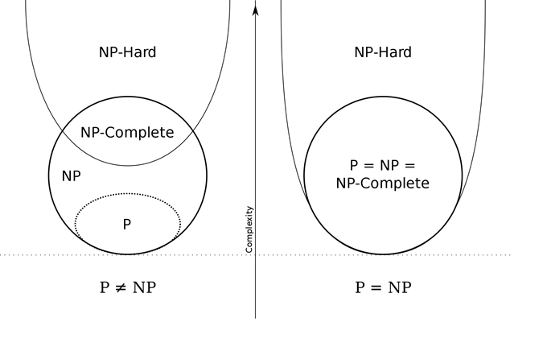
Is P = NP ?
This open mathematical question, after over 50 years of research and millions of dollars of prize money being offered, has no solution
The question ultimately asks, is every problem that is verifiable in polynomial time (NP) actually solvable (or decidable) in polynomial time?
We have been unable to prove one way or another
If even one problem that is NP-Complete can be reduced to P, then P = NP
No one’s done it yet, so most mathematicians and computer scientists suspect that P ≠ NP, but no proof has been created yet

Slide 23
Questions?
Questions?
Comments?
Remarks?

